Slide 1
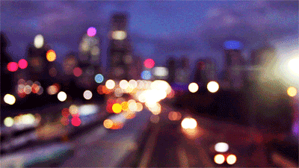
Diy team project TEAM-9 PROJECT-16
AUTONOMOUS ARDUINO TRAFFIC LIGHTS
-ANSHUL (21BT10006)
-BUSIREDDY KRUTHIKA
(21CH10019)
-SHREYA SAINATH DESAI
(21EC30047)

Slide 2


Work done by each team member this week
ANSHUL (21BT10006): HARDWARE AND FINAL MODEL OF THE PROJECT,ANIMATION AND EDITING
BUSIREDDY KRUTHIKA (21CH10019): PRESENTATION AND LAB REPORT
SHREYA SAINATH DESAI (21EC30047):DEMONSTRATION VIDEO AND EDITING , FINAL CODE AND CIRCUIT

Slide 3
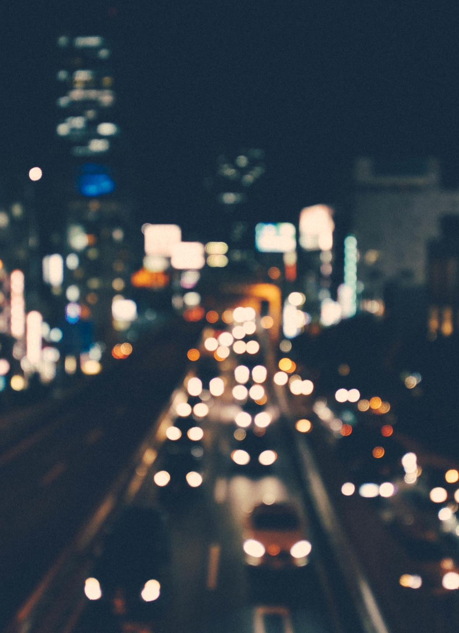
WORK DONE BY EACH MEMBER DURING THE COURSE OF THE PROJECT
ANSHUL (21BT10006) : BASIC MODEL OF ARDUINO TRAFFIC LIGHTS
HARDWARE AND PHYSICAL MODEL OF THE PROJECT ASSISSTANCE IN
CODING, EDITING AND ANIMATION,PRESENTATION(WEEK-1)
BUSIREDDY KRUTHIKA (21CH10019) : SPEED DETECTION USING IR SENSORS,
CODING, SKETCH OF THE PROJECT, LAB REPORT, SCHEMATIC DIAGRAM IN
TINKERCAD AND PRESENTATION (WEEK-3,4)
SHREYA SAINATH DESAI (21EC30047): CODE FOR VEHICLE DETECTION AND
COUNTING USING OPENCV AND PYTHON, MODIFICATION AND
COMPAILATION OF CODE OF THREE SUB-PROJECTS AND FINAL
CIRCUIT,DEMONSTRATION VIDEO AND EDITING, PRESENTATION (WEEK-2)

Slide 4
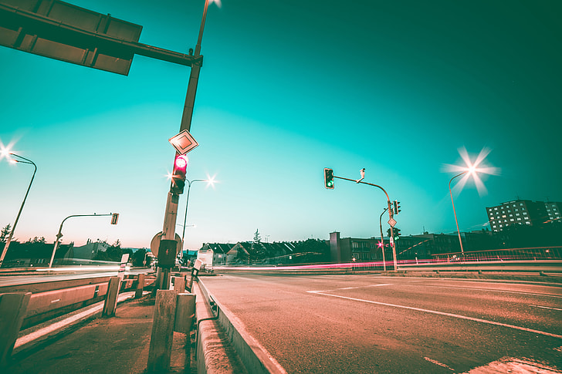
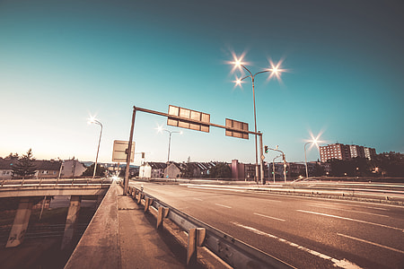
Summary of the project
In this project we built an autonomous Arduino traffic lights demonstration model. Firstly, we divided this project into three sub-projects (Basic traffic lights, IR sensor and Vehicle detection). Then we ordered the hardware parts and started preparing the code. Earlier, we had an idea of using a video for detecting and counting the vehicles. But then we realized that a picture would work perfectly well. So we modified the code and made a final sketch of the working model. Finally, we have assembled all the hardware parts and made a working model of Arduino traffic lights with speed and vehicle detection features.

Slide 5

TRAFFIC LIGHTS:
In this sub-project, we have used a Arduino uno, breadboard, LEDs (red, yellow, green),resistors and cables. Each led has an individual control pin to which digital high and loW signals were provided. Leds glow in a particular sequence given by us.
IR sensor :
In this sub-project we have used a Arduino uno, breadboard, ir sensors and connecting wires. First, two digital ir sensors consisting of ir transmitter and receiver were set up. Ir transmitter will emit radiations and path traced by radiations will give all the information. Code was uploaded to the Arduino and we were able to get the speed of A car.
Vehicle detection :
IN THIS SUB-PROJECT, WE HAVE USED THE OPENCV SOFTWARE AND SPECIFICALLY HAAR CASCADE CLASSIFIER ALONG WITH PYTHON TO DETECT AND COUNT THE NUMBER OF VEHICLES. WE HAVE USED A CAMERA WHICH TAKES PICTURE 5 SECS BEFORE THE START OF THE GREEN LIGHT AND SENT IT TO THE COMPUTER.THEN THE COMPUTER RAN THE CODE, DETECTED AND COUNTED THE NUMBER OF VEHICLES AND SENT IT BACK TO THE ARDUINO.

Slide 6
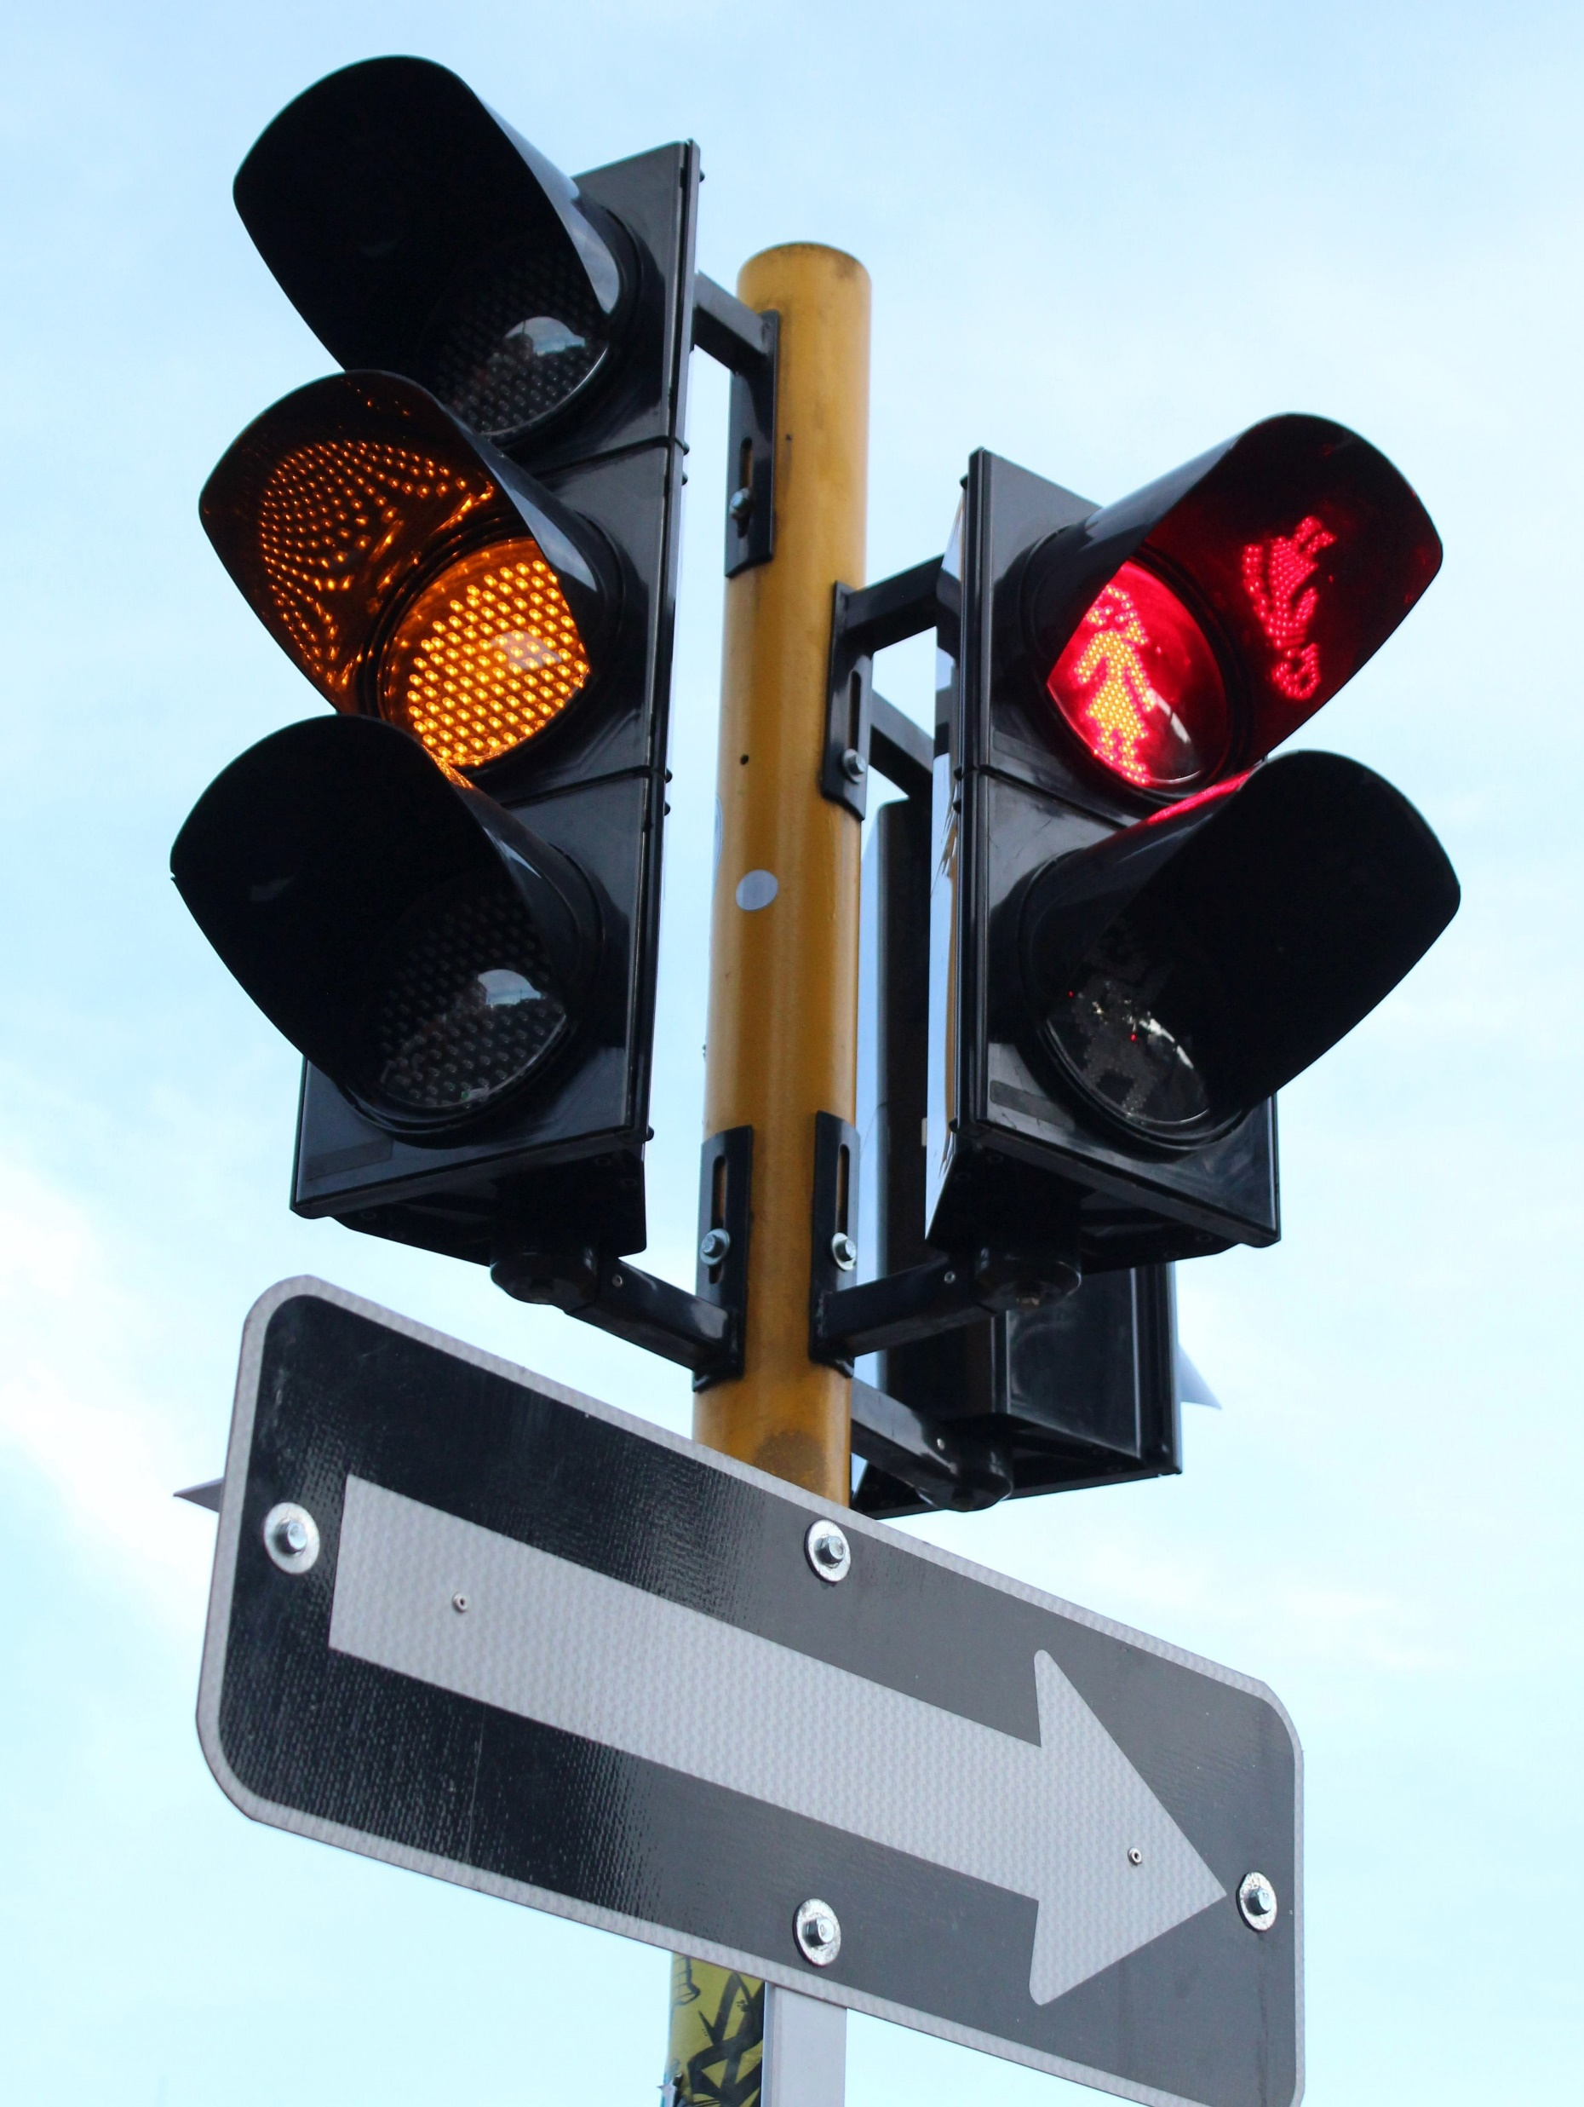

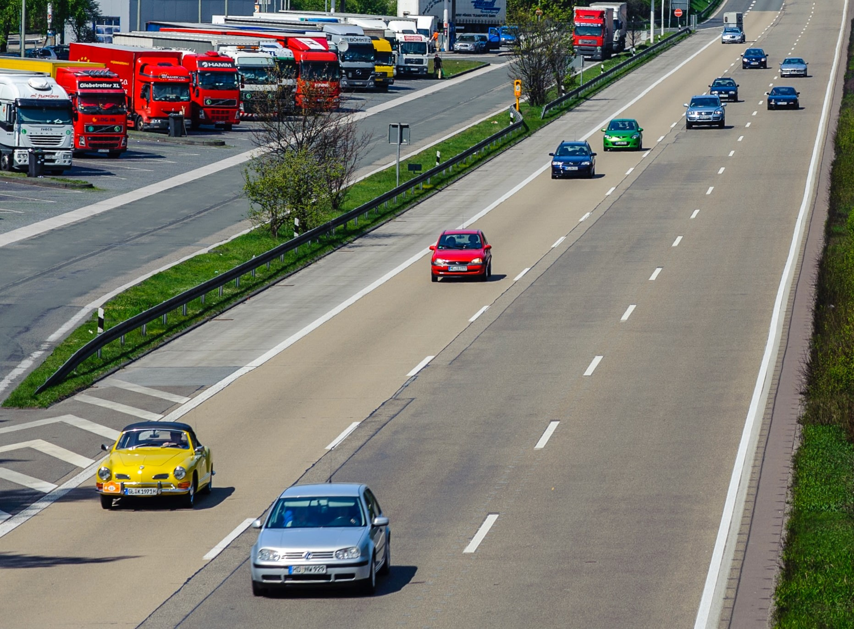
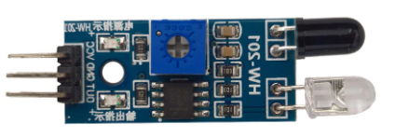
SCHEMATIC OF THE PROJECT
SENDS THE RED LIGHT TIME TO THE OTHER SIGNALS AT THE SAME JUNCTION SO THAT ALL OF THEM CAN BE IN SYNC
SENDS THE GREEN LIGHT TIME TO THE SIGNAL
DETECTS AND COUNTS THE NUMBER OF VEHICLES. CALCULATES THE TIME REQUIRED BY THEM TO CROSS THE SIGNALING
SENDS THE PICTURE TO THE LOCAL COMPUTER
TRAFFIC LIGHTS
(ARDUINO SETUP)
THE CAMERA INSTALLED AT THE TRAFFIC LIGHT TAKES A PICTURE OF THE CARS AT THE SIGNAL BEFORE THE BEGINNING OF THE GREEN SIGNAL
LOCAL COMPUTER
SENDS A SIGNAL TO THE COMPUTER IF IT DETECTS A VEHICLE GOING ABOVE SPEED LIMITS SO THAT THE TRAFFIC POLICE CAN GET ALERT
CHECKS THE SPEED OF VEHICLES PASSING BY IT
IR SENSORS

Slide 7
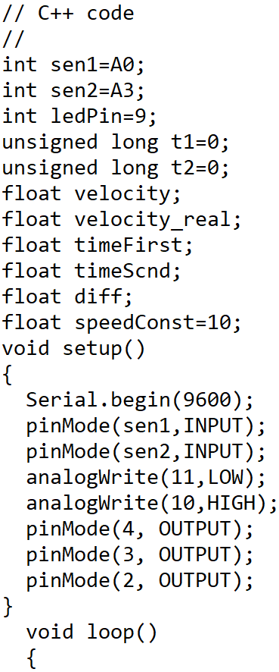
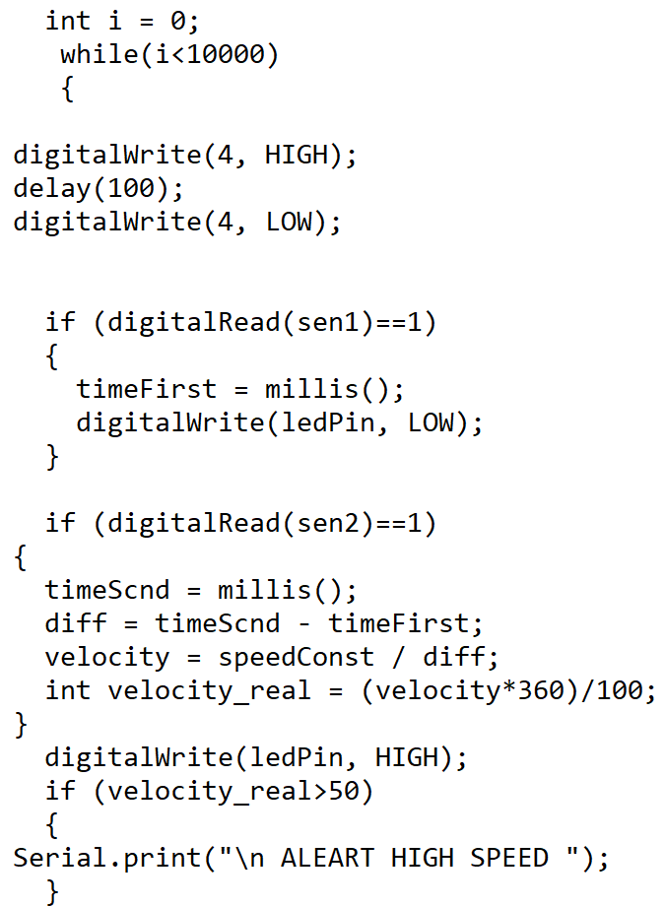
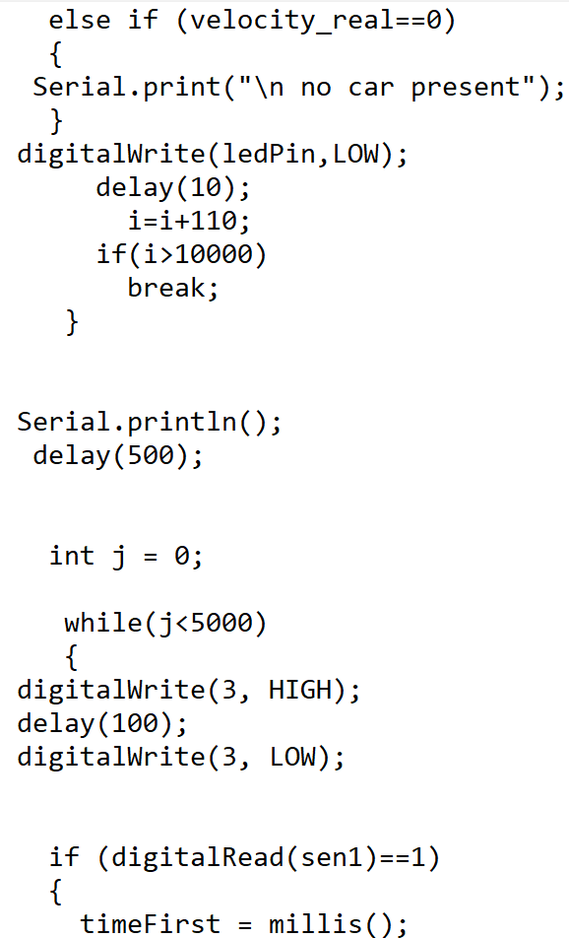
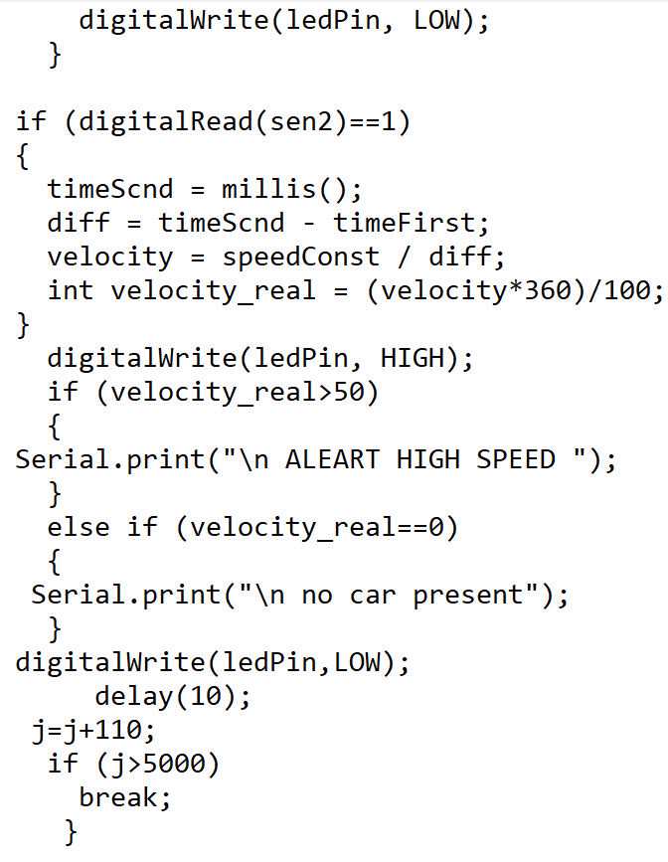
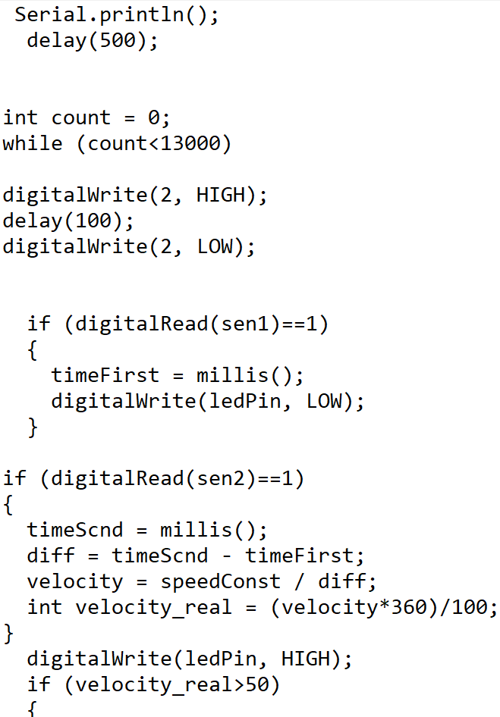
FINAL CODE -SHREYA SAINATH DESAI (21EC30047)
ARDUINO CANNOT RUN TWO LOOPS SIMULTANEOUSLY. SO WE HAD TO MODIFY AND COMBINE THE CODES.

Slide 8
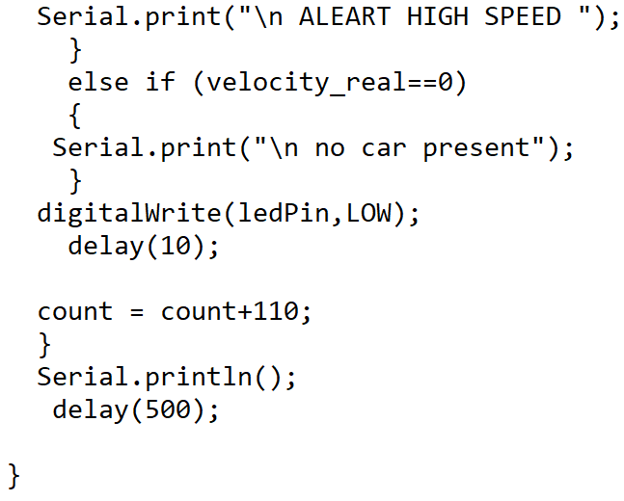
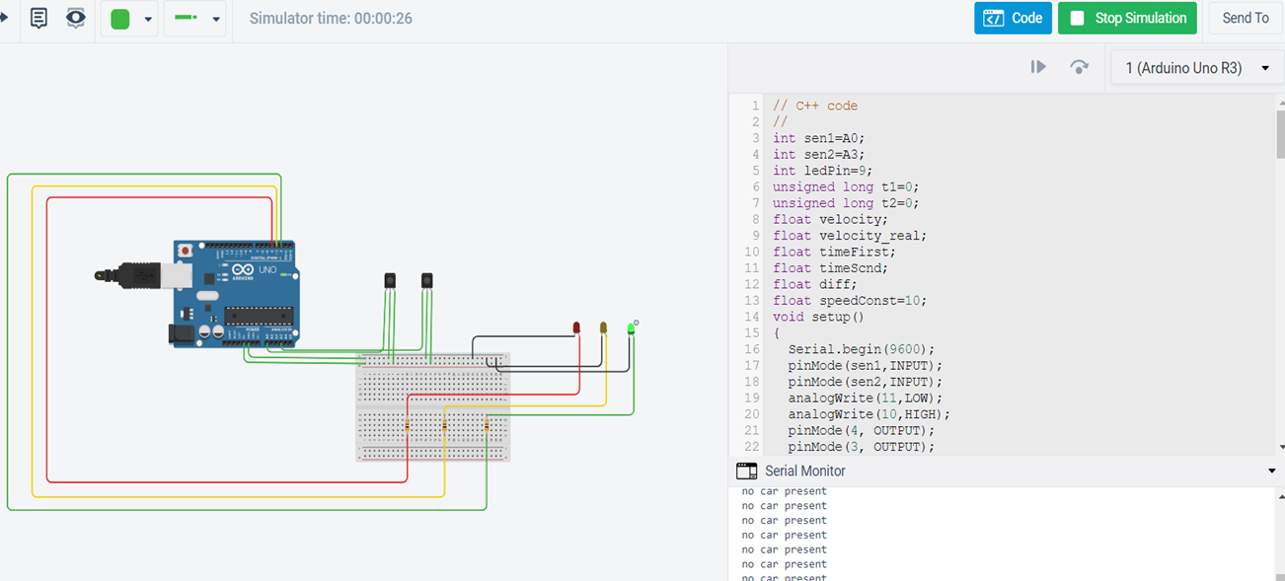

Slide 9
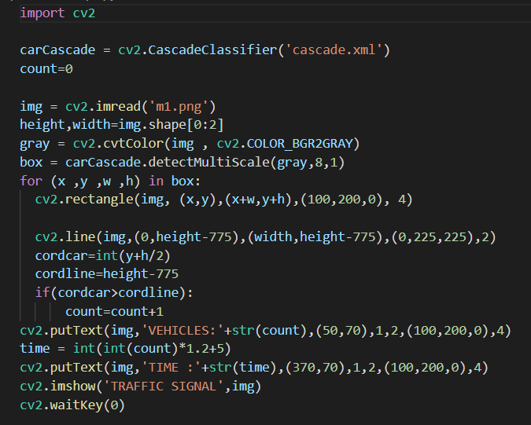
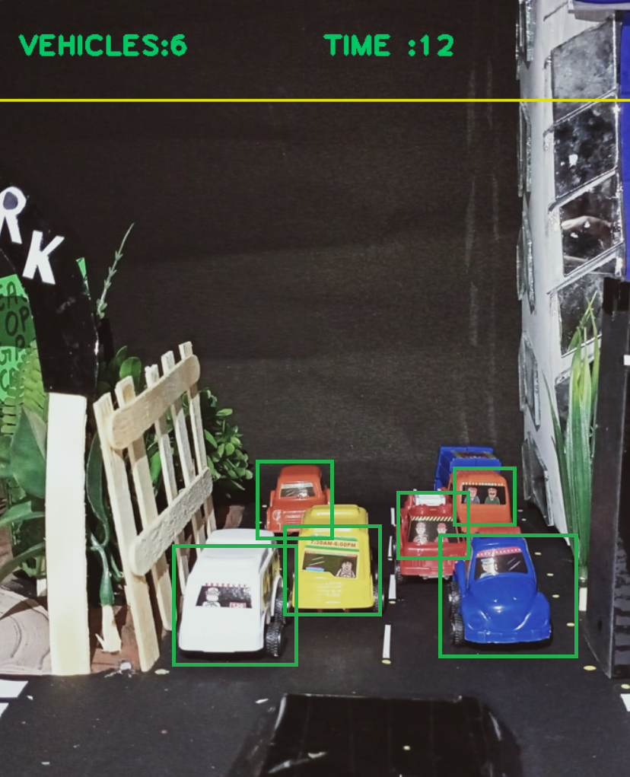

Slide 10
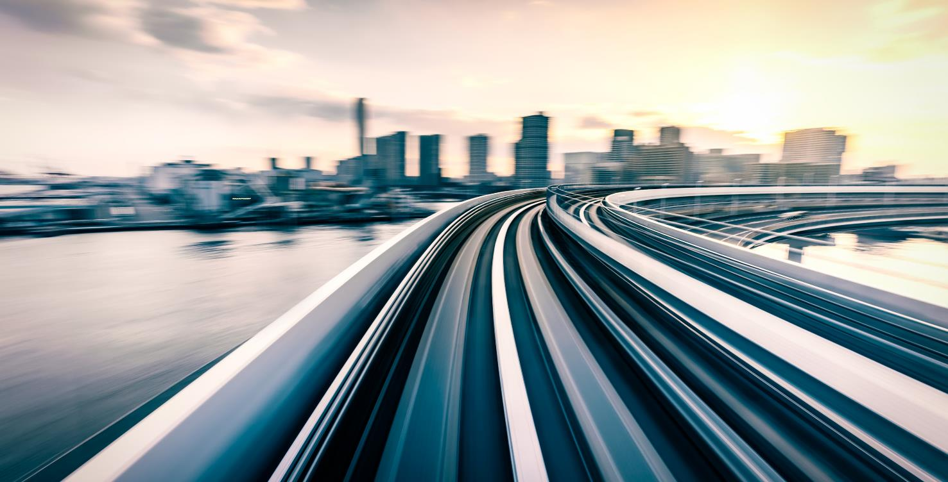
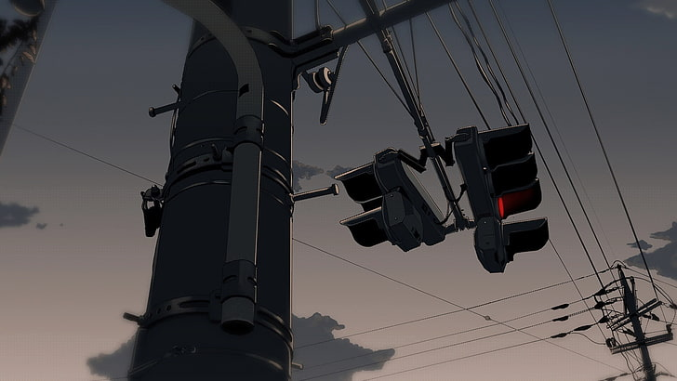

THE PRESENTATION AND THE FINAL REPORT
WORK DONE BY BUSIREDDY KRUTHIKA
(21CH10019)

Slide 11
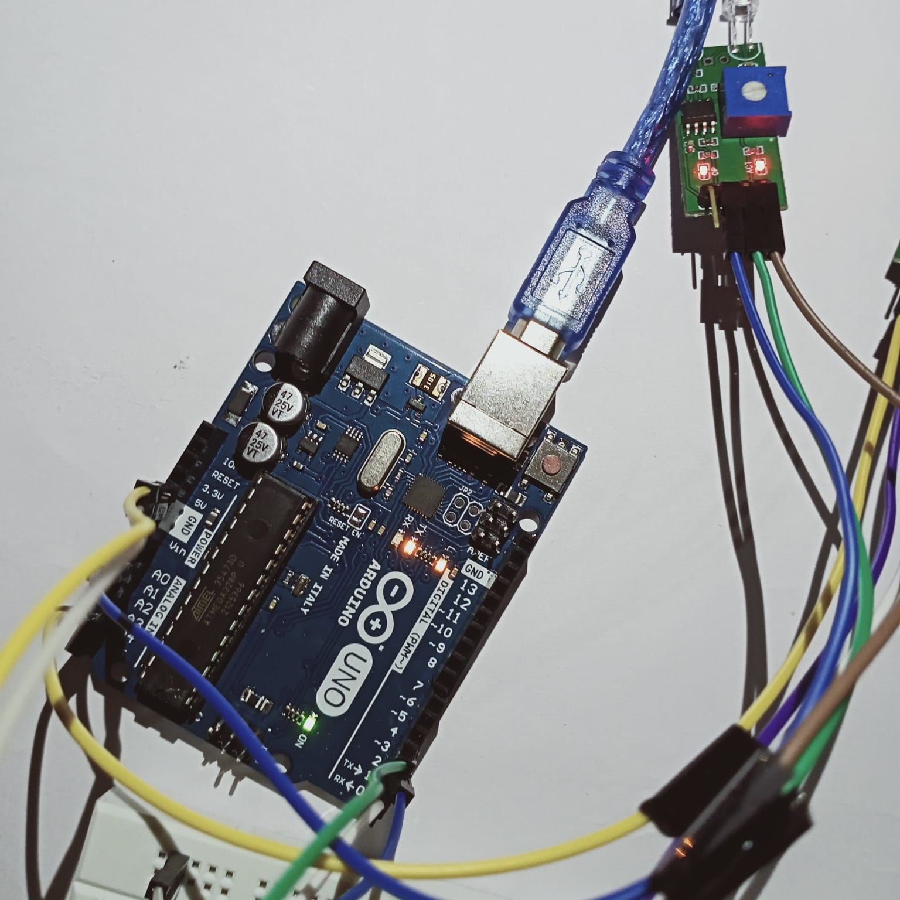
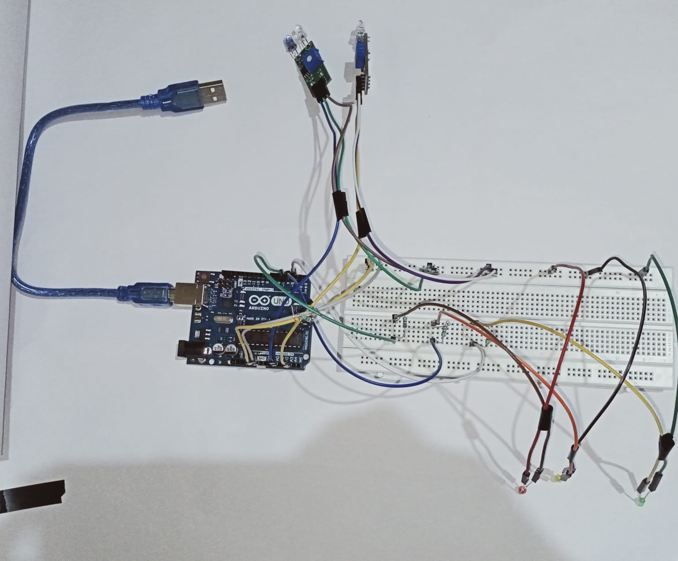
HARDWARE AND FINAL MODEL

Slide 12
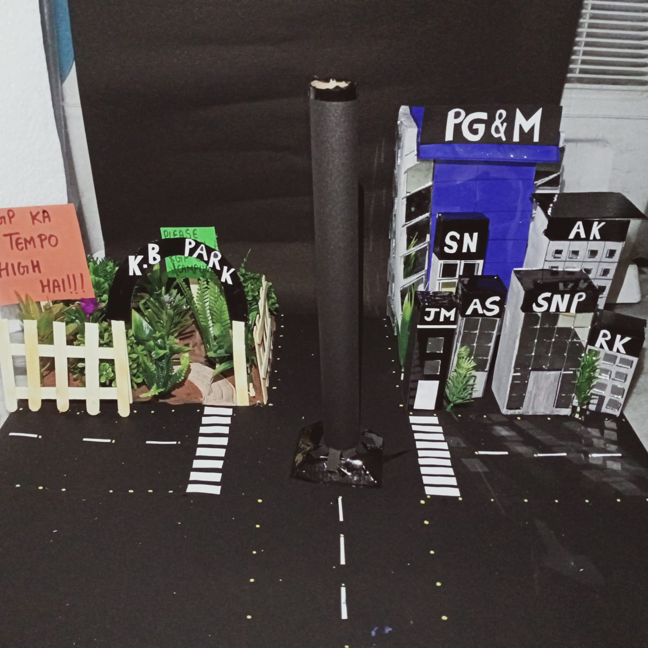
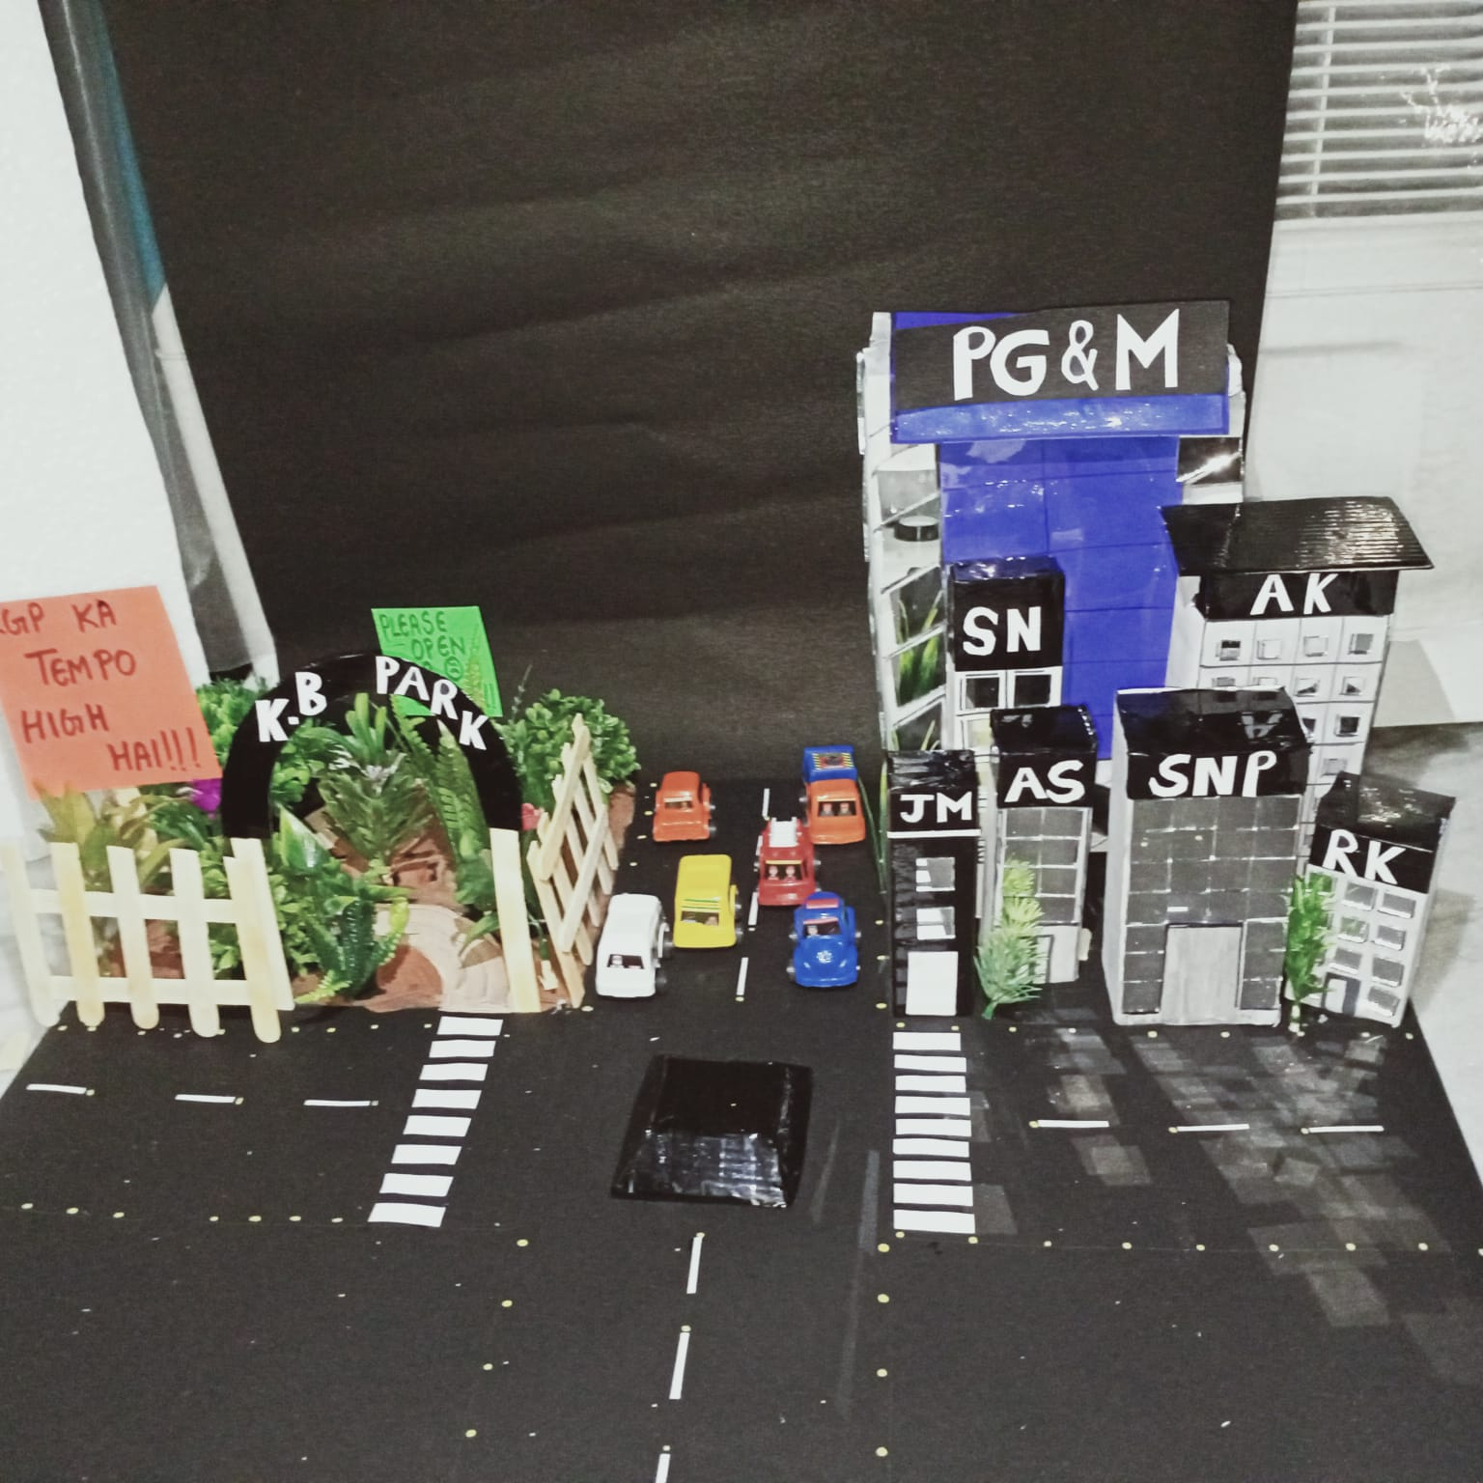

Slide 13
DRAWBACKS AND SCOPE OF IMPROVEMENT IN THE PROJECT
WE WERE NOT ABLE TO INCORPORATE LCD INTO OUR PROJECT AS THE SPEED DISPLAY ON THE LCD WAS UNNECESSARY BECAUSE THE ALERT SIGNAL WOULD DIRECTLY GO TO THE SERIAL MONITOR AND THEN TO THE TRAFFIC POLICE.
WE REALIZED THAT USING IR SENSOR IS NOT THE BEST METHOD TO DETECT SPEED OF THE VEHICLES AS IT DOSENOT WORK IF MULTIPLE VEHICLES PASS ACROSS THE SETUP . WE THOUGHT OF USING COMPUTER VISION FOR THE SPEED DETECTION AS WELL,WHICH WOULD MAKE IT MUCH MORE EFFICIENT, BUT IT WAS TOO LATE AS THE IR SENSORS HAD ALREADY ARRIVED.
THE LAST POINT IS THAT WE HAVE MADE THIS MODEL BY KEEPING ONE TRAFFIC INTERSECTION IN MIND. BUT IN REAL LIFE, THE TRAFFIC JUNCTIONS ARE SYNCHRONIZED. TRAFFIC SIGNAL SYNCHRONIZATION IS A TRAFFIC ENGINEERING TECHNIQUE OF MATCHING THE GREEN LIGHT TIMES FOR A SERIES OF INTERSECTIONS TO ENABLE THE MAXIMUM NUMBER OF VEHICLES TO PASS THROUGH. BUT THIS ABSOLUTELY RANDOM ALLOCATION OF THE SIGNAL TIME FOR EVERY ROUND WOULD RESULT IN A VERY HAPHAZARD STRUCTURE. SO WE NEED A MORE STATISTICALLY BACKED MODEL WHICH WOULD PRESERVE THE SYNCHRONICITY OF THE JUNCTIONS ALONG WITH INCORPORATING THE MAIN FEATURES OF THIS PROJECT.

Slide 14
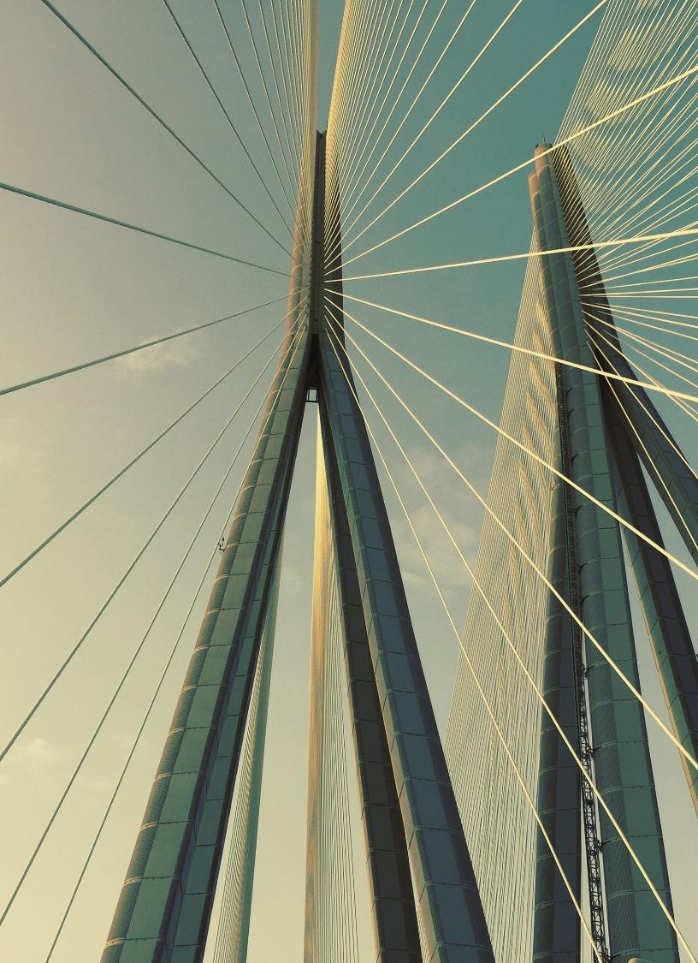
Acknowledgement we wish to express our sincere gratitude to our professors for giving this opportunity to do this project. we are grateful to prof.c mandal, prof. korak Sarkar and prof. sreeraj for their valuable guidance, encouragement and advice rendered to us at every stage. The guidance and support received from all the members who contributed to this project was vital for the completion. We are grateful to all the guidance and constant support towards the completion of our project. thank you

